Slide 1

Monitoring Factory Workers’ Daily Performance & Attrition
Muhammad Al-farisy

Slide 2

Muhammad Al-farisy
Education
DIII - Accounting – Politeknik Negeri Lhokseumawe (2015-2018)
S1 - Accounting – Universitas Pasundan (2019-2020)
Working
Data Analyst

Slide 3
Project Background

Slide 4
Project Background
The organizational structure of this factory consists of 508 permanent workers, but due to employee turnover, the number of individuals appearing in the data reaches 687 people. This indicates a change in the workforce due to layoffs, resignations, or placement of new employees.
To monitor the movement of data that is updated every day, a tool is needed to update data to users and report every day so that users can make decisions regarding the condition of the company's management employees towards the company.
Souce Data : https://www.kaggle.com/datasets/gladdenme/factory-workers-daily-performance-attrition-s

Slide 5
Problem Statement

Slide 6
Problem Statement
This project aims to upgrade the process of sending data to the data warehouse and update to reporting. The main challenges include:
Build Automation ETL
Build Automated Reporting
Project Goals
Automate data extraction from CSV data folder using Python and airflow in docker
Database Postgres.
Visualization in Power BI.

Slide 7
Data Platform Understanding

Slide 8
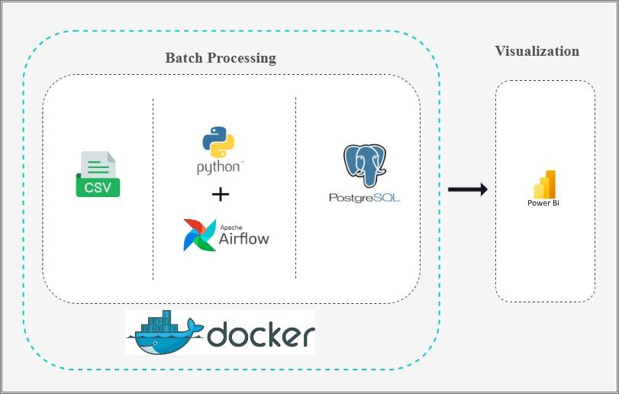

Slide 9
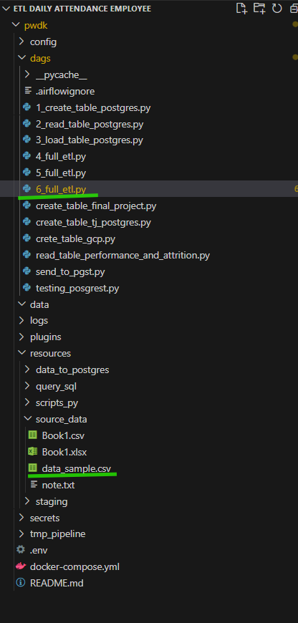
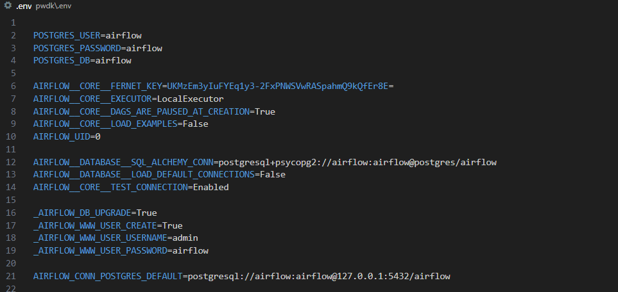

Slide 10
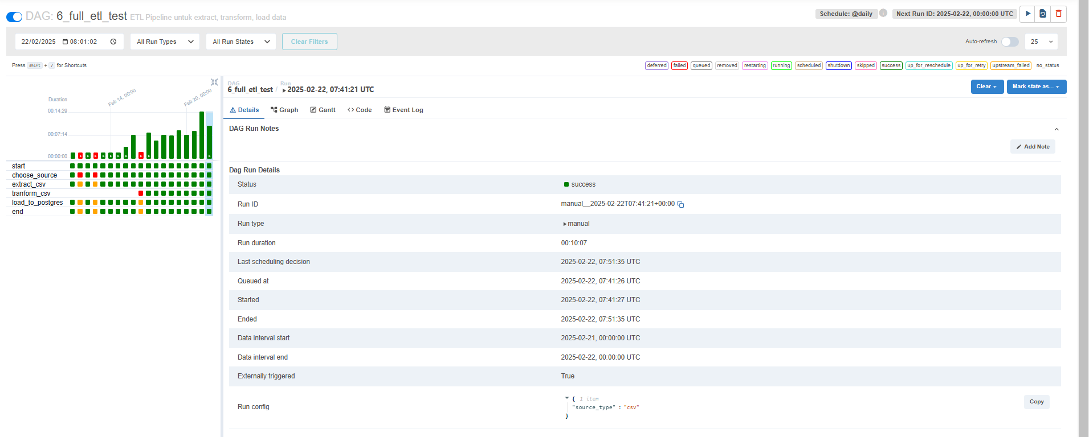
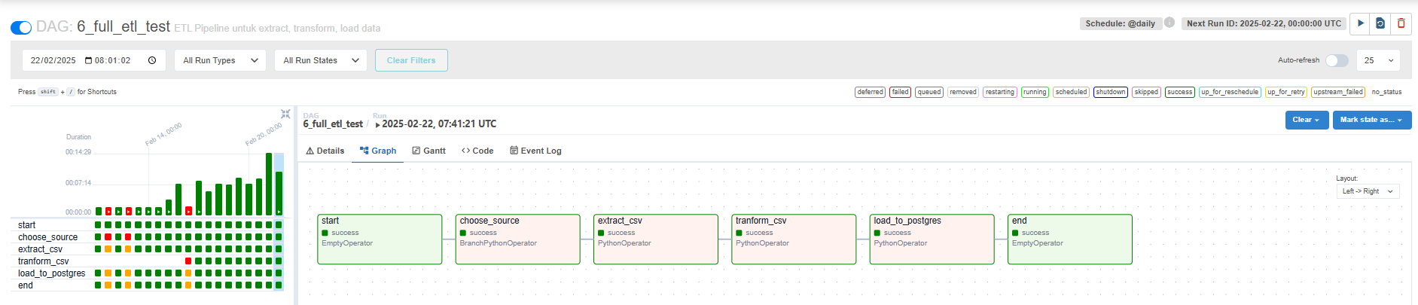

Slide 11
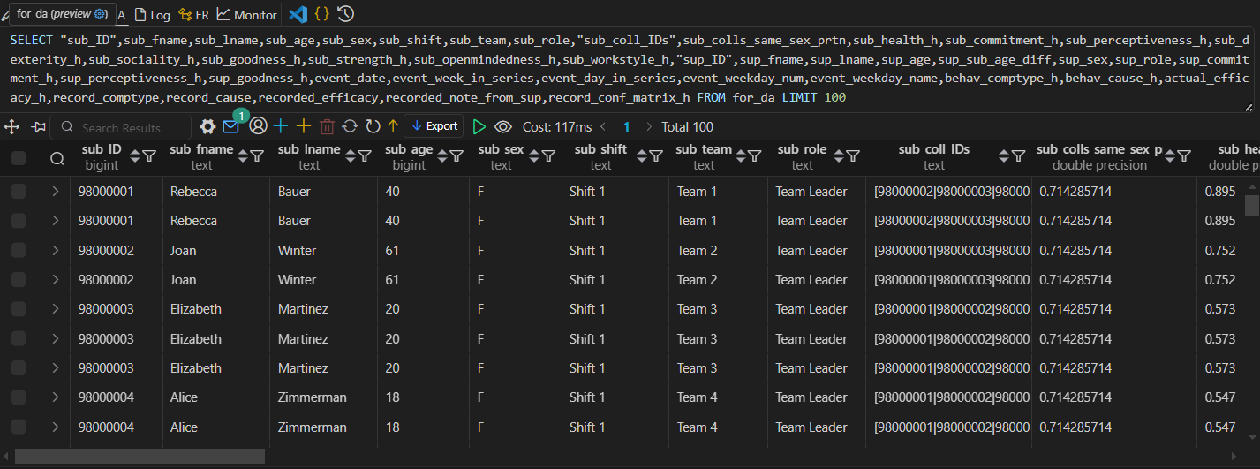

Slide 12
Data Understanding

Slide 13
Data Sources & Collection
Source: CSV (Kaggle)
Collected Data : All column.
Extraction Data: Airflow DAG
Data Processing & Storage
Processing:
Cleansing “,” to “|”
Storage:
Postgres

Slide 14
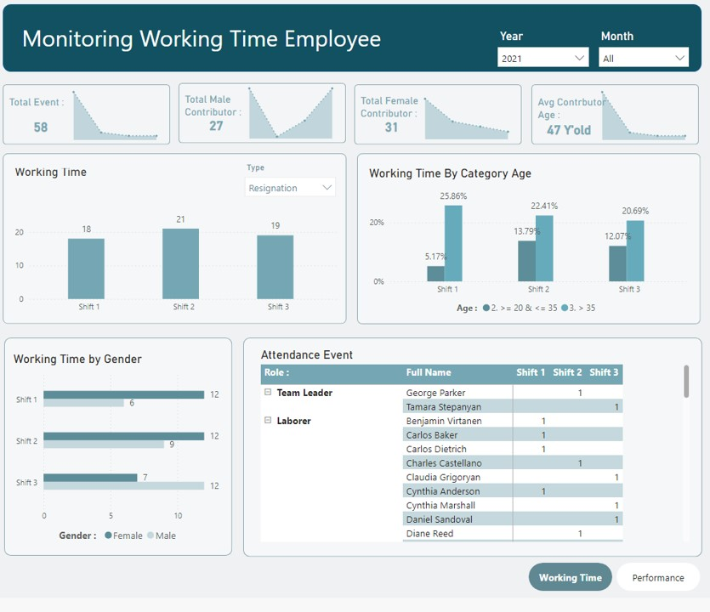
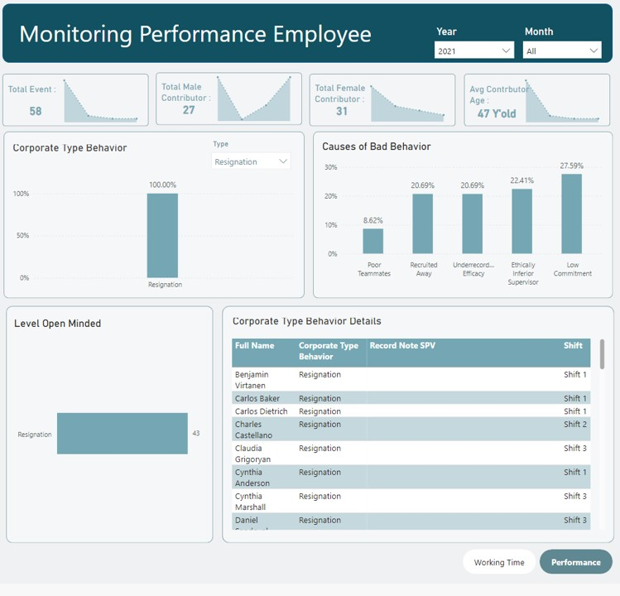
Power BI Report
Monitoring Factory Workers’ Daily Performance & Attrition

Slide 15
Conclusion & Recommendation

Slide 16
Conclusion :
For simple ETL can use the method from this platform using Python, Airflow, Posgtres which run in Docker.
Recommendation :
For the development of this platform, can separate the extract, transform and load files to facilitate maintenance.
Source data can be connected to on-prime and cloud databases.
For this ETL, it can be updated using the Streaming method.

Slide 17
Terima
Kasih.

